Slide 1
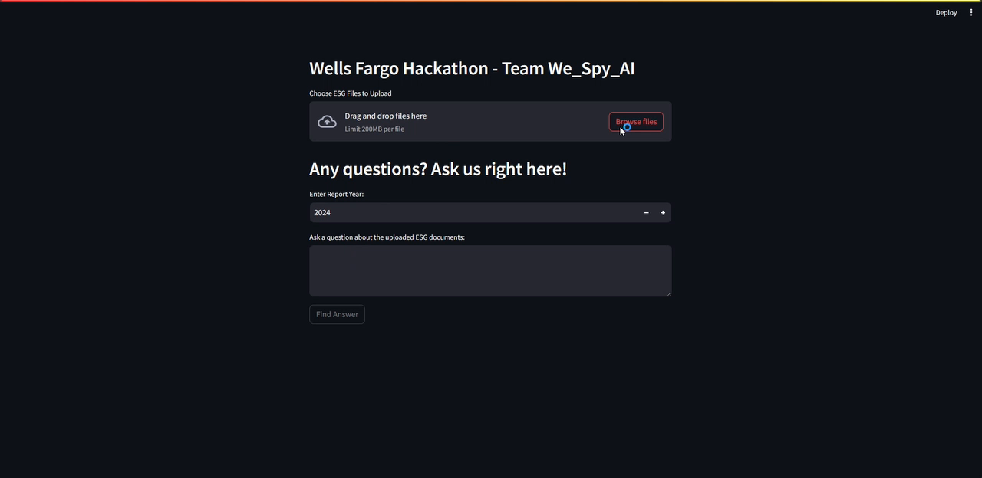
Team 64 – We_Spy_AI
Upload Activities

